Slide 1
Programming Logic and Design Ninth Edition
Chapter 5
Looping

Slide 2
Objectives
In this chapter, you will learn about:
The advantages of looping
Using a loop control variable
Nested loops
Avoiding common loop mistakes
Using a for loop
Using a posttest loop
Characteristics shared by all structured loops
Common loop applications
Similarities and differences between selections and loops

Slide 3
Appreciating the Advantages of Looping
Looping makes computer programming efficient and worthwhile
Write one set of instructions to operate on multiple, separate sets of data
Less time required for design and coding
Fewer errors
Shorter compile time
Loop: a structure that repeats actions while some condition continues

Slide 4
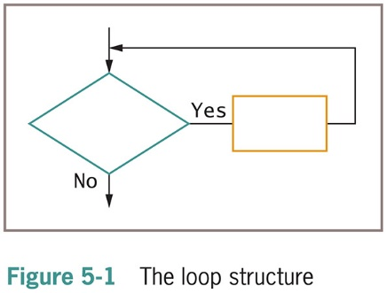
Appreciating the Advantages of Looping (continued -1)
Dual-alternative (or binary) selection structure
Provides an action for each of two possible outcomes

Slide 5
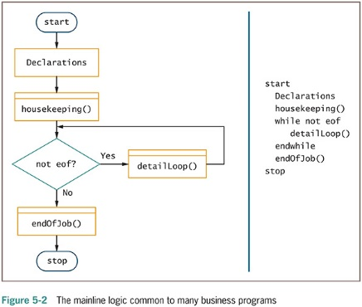
Appreciating the Advantages of Looping (continued -2)

Slide 6
Using a Loop Control Variable
As long as a condition remains true, the statements in a while loop’s body execute
Control number of repetitions
Loop control variable initialized before entering loop
Loop control variable tested
Body of loop must alter value of loop control variable
Repetitions controlled by:
Counter – used to create a definite counter-controlled loop
Sentinel value – used to create an indefinite loop

Slide 7
Using a Definite Loop with a Counter
Definite loop
Executes a predetermined number of times
Counter-controlled loop or counted loop
Program counts loop repetitions
Loop control variables altered by:
Incrementing
Decrementing
Counter
Any numeric variable that counts the number of times an event has occurred, usually starts with 0

Slide 8
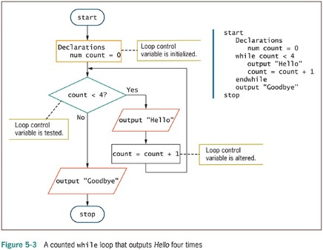
Using a Definite Loop with a Counter(continued -1)

Slide 9
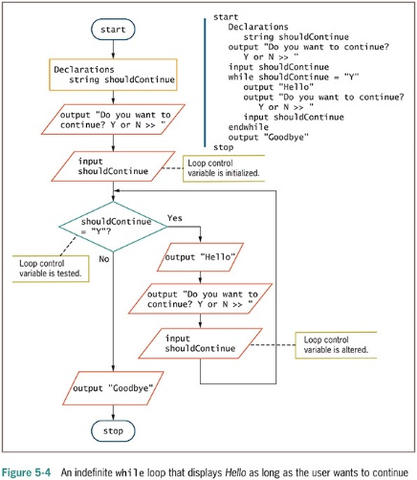
Using an Indefinite Loop with a Sentinel Value
Indefinite loop
Performed a different number of times each time the program executes
The user decides how many times the loop executes

Slide 10
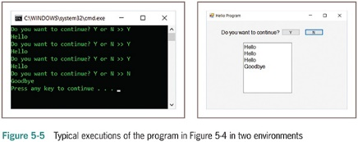
Using an Indefinite Loop with a Sentinel Value (continued -1)

Slide 11
Understanding the Loop in a Program’s Mainline Logic
Three steps should occur in every properly functioning loop:
Provide a starting value for the variable that will control the loop
Test the loop control variable to determine whether the loop body executes
Alter the loop control variable within the loop

Slide 12
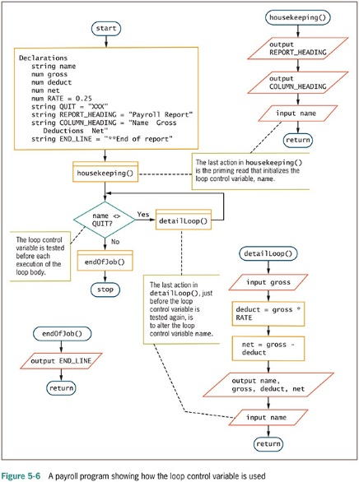
Understanding the Loop in a Program’s Mainline Logic (continued -1)

Slide 13
Nested Loops
Nested loops: loops within loops
Outer loop: the loop that contains the other loop
Inner loop: the loop that is contained
Needed when values of two (or more) variables repeat to produce every combination of values

Slide 14
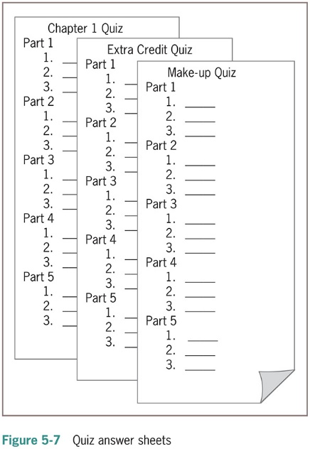
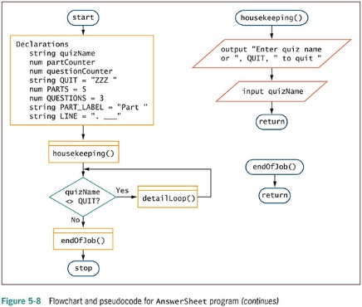
Nested Loops (continued -1)

Slide 15
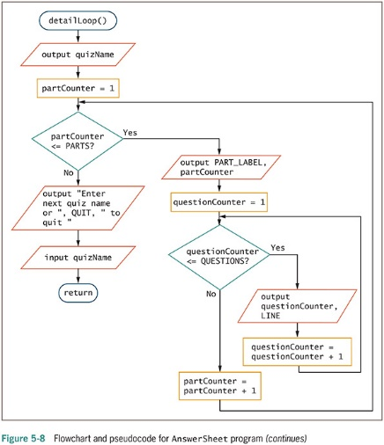
Nested Loops (continued-2)

Slide 16
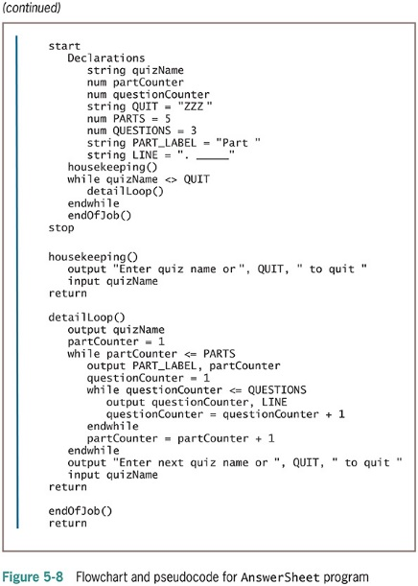
Nested Loops (continued -3)

Slide 17
Nested Loops (continued -4)
Nested Loop facts:
Nested loops never overlap. An inner loop is always completely contained within an outer loop
An inner loop goes through all of its iterations each time its outer loop goes through just one iteration
The total number of iterations executed by a nested loop is the number of inner loop iterations times the number of outer loop iterations

Slide 18
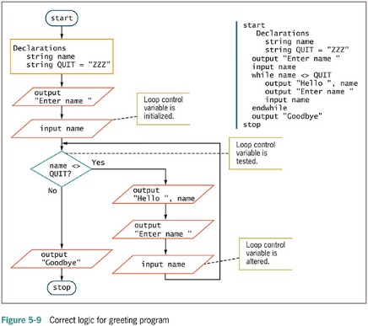
Avoiding Common Loop Mistakes
Mistake: failing to initialize the loop control variable
Example: get name statement removed
Value of name unknown or garbage
Program may end before any labels printed
100 labels printed with an invalid name

Slide 19
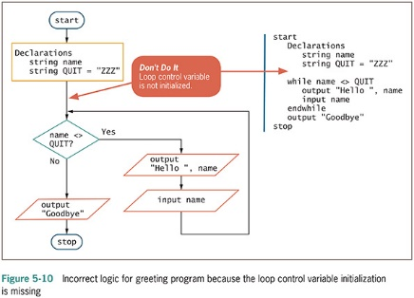
Avoiding Common Loop Mistakes (continued -1)

Slide 20
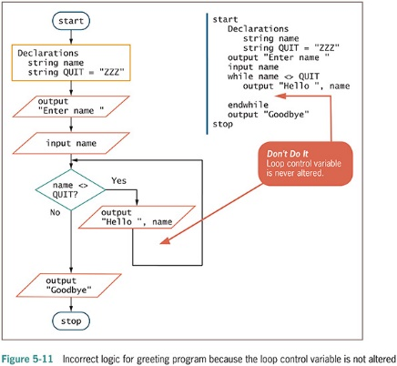
Avoiding Common Loop Mistakes (continued -2)
Mistake: neglecting to alter the loop control variable
Remove get name instruction from outer loop
User never enters a name after the first one
Inner loop executes infinitely
Always incorrect to create a loop that cannot terminate

Slide 21
Avoiding Common Loop Mistakes (continued -3)
Mistake: using the wrong comparison when testing loop control variable
Programmers must use correct comparison
Seriousness depends on actions performed within a loop
Overcharge insurance customer by one month
Overbook a flight on airline application
Dispense extra medication to patients in pharmacy

Slide 22
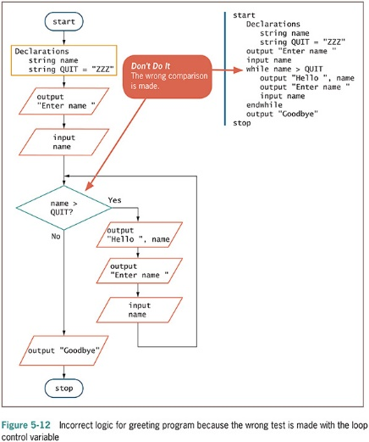
Avoiding Common Loop Mistakes (continued -4)

Slide 23
Avoiding Common Loop Mistakes (continued -5)
Mistake: including statements inside the loop that belong outside the loop
Example: discount every item by 30 percent
Inefficient because the same value is calculated 100 separate times for each price that is entered
Move outside the loop for efficiency

Slide 24
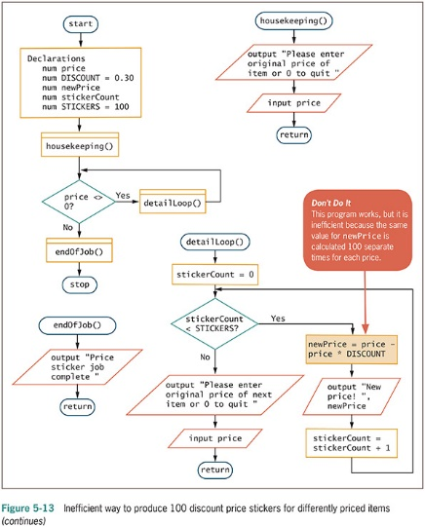
Avoiding Common Loop Mistakes (continued -6)

Slide 25
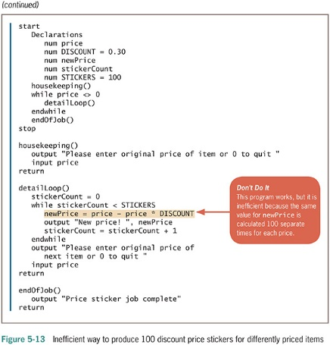
Avoiding Common Loop Mistakes (continued -7)

Slide 26
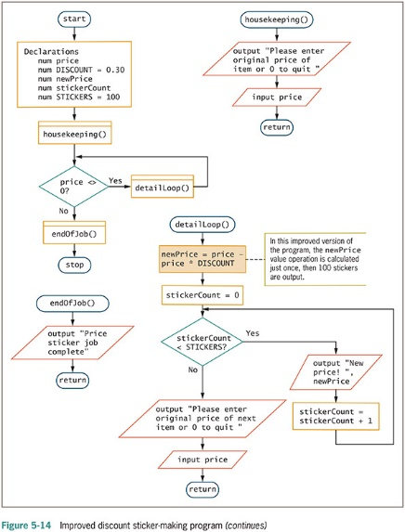
Avoiding Common Loop Mistakes (continued -8)

Slide 27
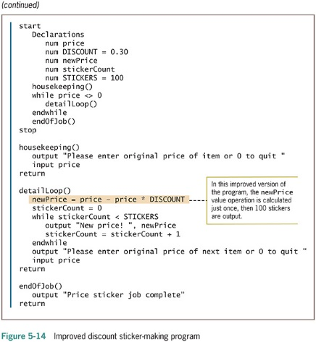
Avoiding Common Loop Mistakes (continued -9)

Slide 28
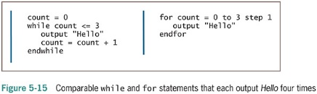
Using a for Loop
for statement or for loop is a definite loop
Provides three actions in one structure:
Initializes
Tests
Alters

Slide 29
Using a for Loop (continued -1)
Example
for count = 0 to 3 step 1
output "Hello"
endfor
Initializes count variable to 0
Checks count variable against the limit value 3
If evaluation is true, for statement body prints the word “Hello”
Increases count by 1 using a step value

Slide 30
Using a for Loop (continued -2)
Step value: the amount by which a loop control variable changes
Can be positive or negative (incrementing or decrementing the loop control variable)
Default step value is 1
Programmer specifies a step value when each pass through the loop changes the loop control variable by a value other than 1

Slide 31
Using a for Loop (continued -3)
while statement could be used in place of for statement
Pretest loop: the loop control variable is tested before each iteration
for loops and while loops are pretest loops

Slide 32
Using a Posttest Loop
Posttest loop: the loop control variable is tested after each iteration
In a posttest loop, the loop body executes at least one time because the loop control variable is not tested until after the first iteration.
do-while loop is a posttest loop
Example
do
pay a bill
while more bills remain to be paid

Slide 33
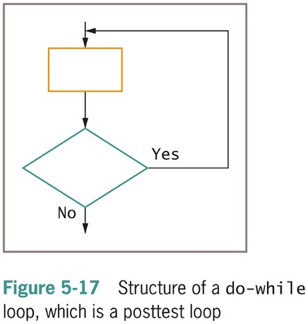
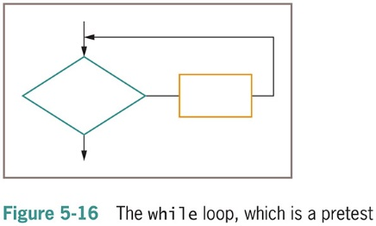
Using a Posttest Loop (continued -1)

Slide 34
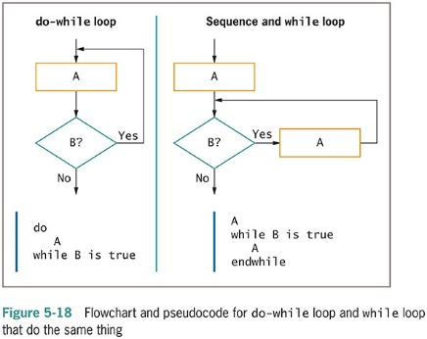
Using a Posttest Loop (continued -2)

Slide 35
Recognizing the Characteristics Shared by Structured Loop
All structured loops have these characteristics:
The loop-controlling evaluation must provide either the entry to or exit from the structure
The loop-controlling evaluation provides the only entry to or exit from the structure
Some languages support a do-until loop, which is a posttest loop that iterates until the loop controlling evaluation is false

Slide 36
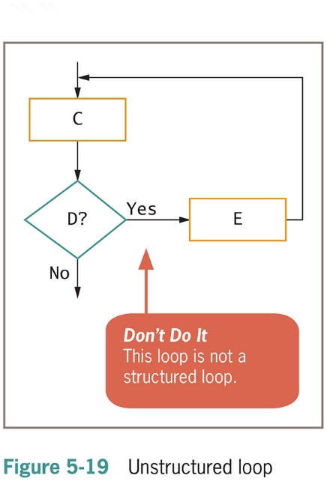
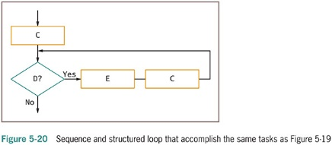
Recognizing the Characteristics Shared by Structured Loop (continued -1)

Slide 37
Common Loop Applications
Using a loop to accumulate totals
Examples
Business reports often include totals
List of real estate sold and total value
Accumulator: variable that gathers values
Similar to a counter
Counter increments by 1
Accumulator increments by some value

Slide 38
Common Loop Applications (continued -1)
Accumulators require three actions
Initialize the accumulator to 0
Accumulators are altered: once for every data set processed
At the end of processing, accumulators are output
Summary reports
Contain only totals with no detail data
Loops are processed but detail information is not printed

Slide 39
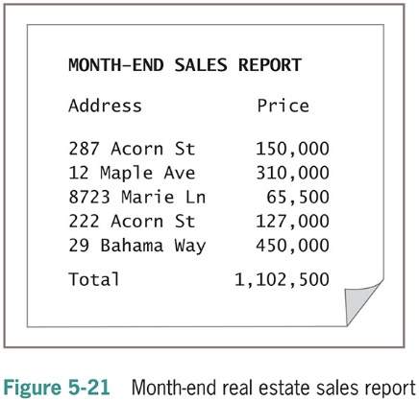
Common Loop Applications (continued -2)

Slide 40
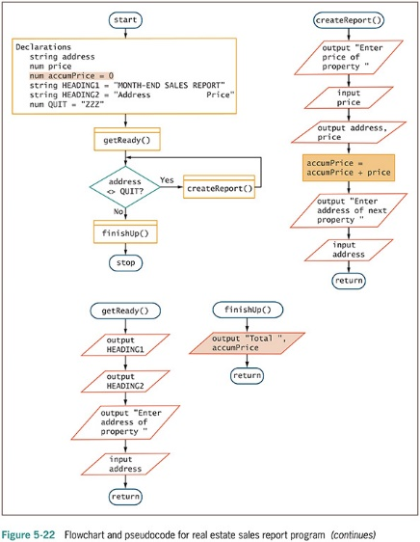
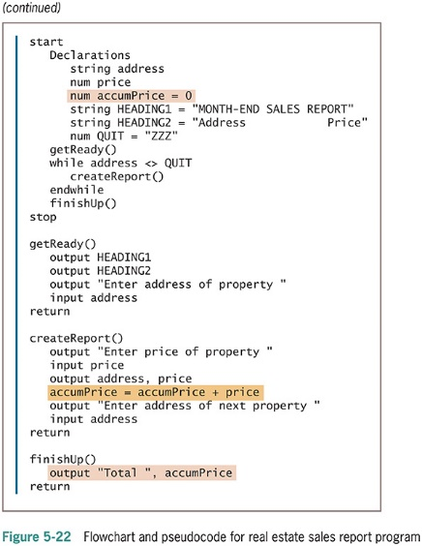
Common Loop Applications (continued -3)

Slide 41
Common Loop Applications (continued -4)
Using a loop to validate data
Defensive programming: preparing for all possible errors before they occur
When prompting a user for data, no guarantee that data is valid
Validate data: make sure data falls in acceptable ranges (month values between 1 and 12)
GIGO: Garbage in, garbage out
Unvalidated input will result in erroneous output

Slide 42
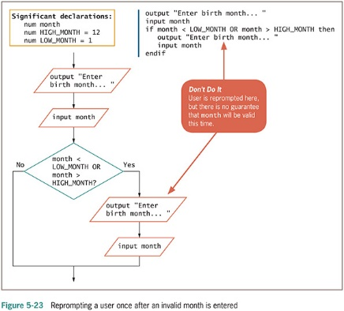
Common Loop Applications (continued -5)

Slide 43
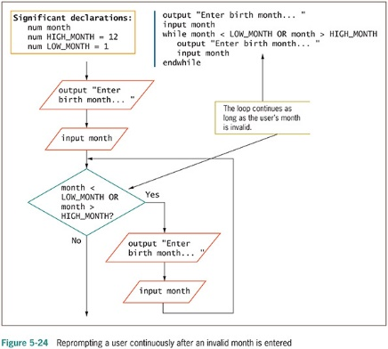
Common Loop Applications (continued -6)

Slide 44
Common Loop Applications (continued -7
Limiting a reprompting loop
Reprompting can be frustrating to a user if it continues indefinitely
Maintain a count of the number of reprompts
Forcing a data item means:
Override incorrect data by setting the variable to a specific value

Slide 45
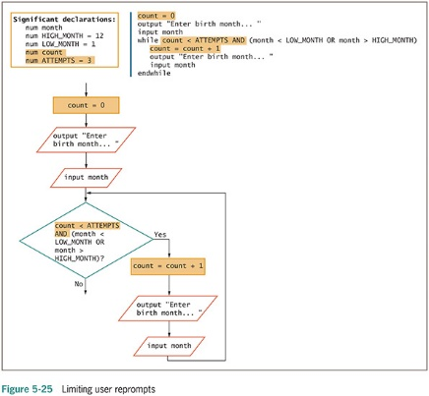
Common Loop Applications (continued -8)

Slide 46
Common Loop Applications (continued -9)
Validating a data type
Validating data requires a variety of methods
isNumeric() or similar method
Provided with the language translator you use to write your programs
Black box
isChar() or isWhitespace() or isUpper()
Accept user data as strings
Use built-in methods to convert to correct data types

Slide 47
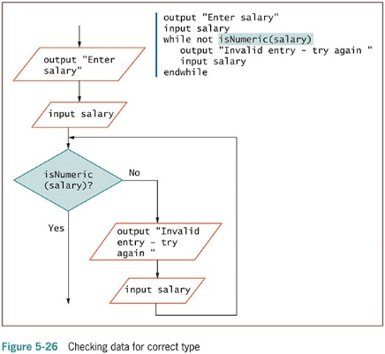
Common Loop Applications (continued -10)

Slide 48
Common Loop Applications (continued -11)
Validating reasonableness and consistency of data
Many data items can be checked for reasonableness
Good defensive programs try to foresee all possible inconsistencies and errors

Slide 49
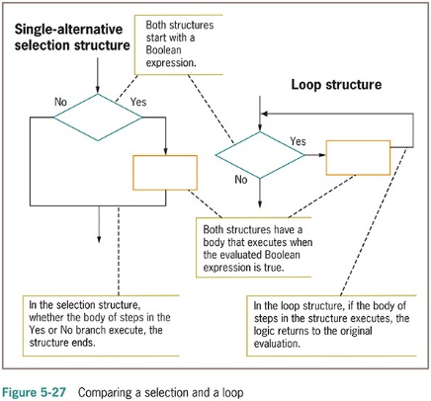
Common Loop Applications (continued -12)
Comparing Selections and Loops
Selection Structure
The two logical paths (True and False) join together
Loop Structure
One of the logical branches returns to the same decision

Slide 50
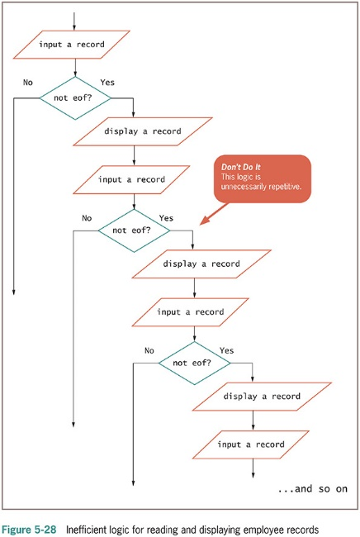
Common Loop Applications (continued -13)

Slide 51
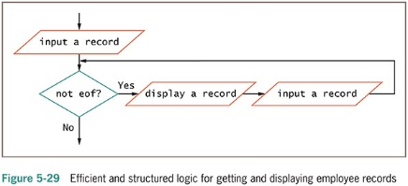
Common Loop Applications (continued -14)

Slide 52
Summary
Loops write one set of instructions that operate on multiple, separate sets of data
Three steps must occur in every loop
Initialize the loop control variable
Compare the variable to some value
Alter the variable that controls the loop
Nested loops: loops within loops
Nested loops maintain two individual loop control variables
Alter each at the appropriate time

Slide 53
Summary (continued -1)
Common mistakes made by programmers
Neglecting to initialize the loop control variable
Neglecting to alter the loop control variable
Using the wrong comparison with the loop control variable
Including statements inside the loop that belong outside the loop
Most computer languages support a for loop
for loop used when the number of iterations is known
In a posttest loop, the loop body executes at least one time because the loop control variable is not tested until after the first iteration

Slide 54
Summary (continued -2)
Loops are used to accumulate totals in business reports and to reprompt users for valid data
In the selection structure the two logical paths that emerge from a test join together following their actions
In the loop structure, the paths that emerge from the test do not join together, instead, one of the paths eventually returns to the same test

